Slide 1
Credit Card Fraud Detection
AUTHOR: ABDUS SAMAD ABDULLAH
COURSE DSC-18

Slide 2
CONTENTS
Objective
Background
Data Cleaning
Exploratory Data Analysis (EDA)
Model Building -1
Model Building -2 (Cost Benefit Analysis)
Conclusions
Recommendations

Slide 3

OBJECTIVE
To develop a machine learning model to detect fraudulent transactions based on the historical transactional data of customers with a pool of merchants.

Slide 4
Background
Credit card fraud is an inclusive term for fraud committed using a payment card, such as a credit card or debit card.
The purpose may be to obtain goods or services, or to make payment to another account which is controlled by a criminal.
In the banking industry, detecting credit card fraud using machine learning is not just a trend; it is a necessity for banks, as they need to put proactive monitoring and fraud prevention mechanisms in place.
Machine learning helps these institutions reduce time-consuming manual reviews, costly chargebacks and fees, and denial of legitimate transactions.

Slide 5
Understanding and Defining Fraud
Credit card fraud is any dishonest act or behaviour to obtain information without the proper authorisation of the account holder for financial gain. Among the different ways of committing fraud, skimming is the most common one. Skimming is a method used for duplicating information located on the magnetic stripe of the card. Apart from this, other ways of making fraudulent transactions are as follows:
Manipulation or alteration of genuine cards
Creation of counterfeit cards
Stolen or lost credit cards
Fraudulent telemarketing

Slide 6
Data
The shape of the Train dataset is (1296675, 23)
The shape of the Test dataset is (555719, 23)
Merging both the data set .
The train and test data obtained from kaggle are concatenated with credit_train on top of credit_test for further operations.
The shape of the combined dataset is (1852394, 22)

Slide 7
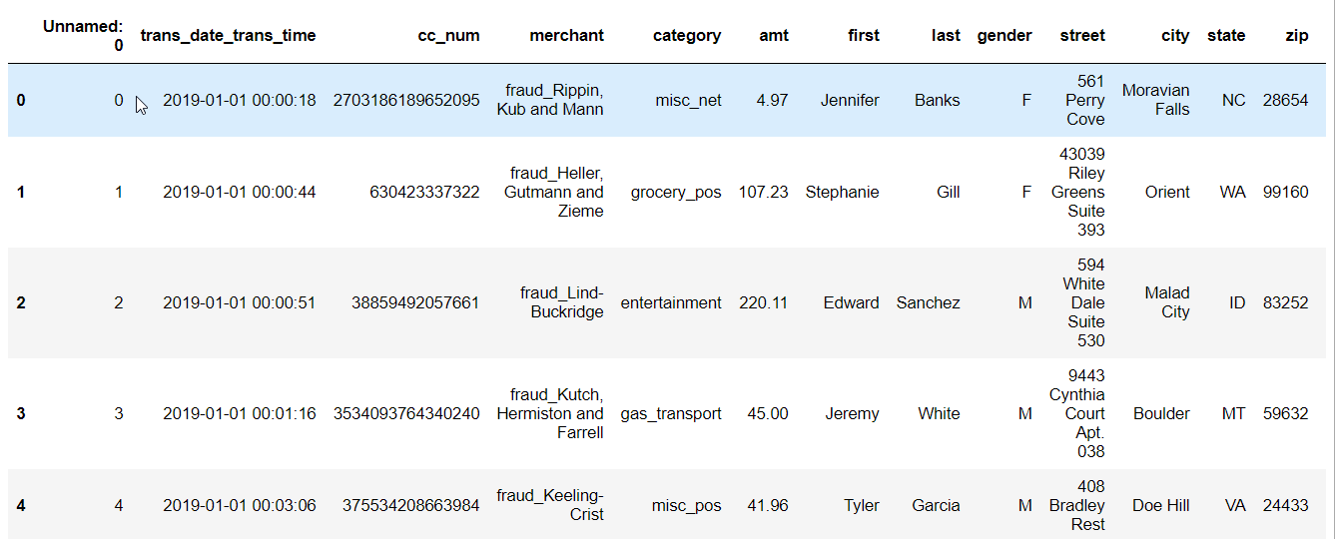
Data

Slide 8

Data Cleaning
Dropped the features which are not useful ((['first', 'last','dob','unix_time','job','state','street'])
Split feature “ trans_date_trans_time“ to ‘Transaction_date’ & ‘Transaction_Time’.
Data Check: No Missing Values but the present of Outliers.

Slide 9
693 unique merchants classified as [high, medium, low] risk merchants based on number of fraudulent transactions.
The unique values in categories are 14.
The cities are binned as [high, medium, low] risk cities.
Fraudulent transactions time ranges are:
10 pm - 4 am 8169
4 pm - 10 pm 606
10 am - 4 pm 489
4 am - 10 am 387

Slide 10

Exploratory Data Analysis
The dataset is highly imbalanced with just 0.52% fraudulent transactions.
The plots of transaction amount and City Population suggest large number of outliers in both the features.
These will be treated using the appropriate methods below

Slide 11
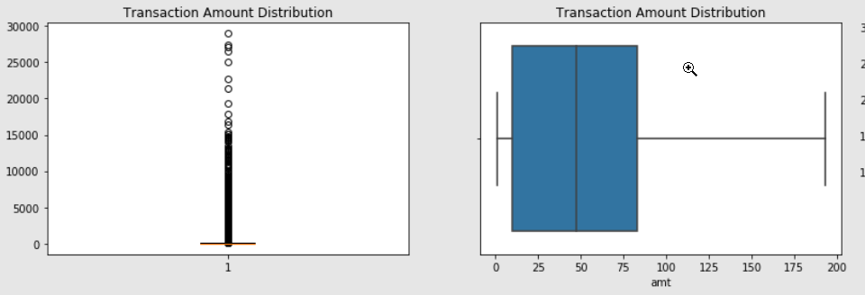
Outlier Treatment of feature ‘amt’

Slide 12
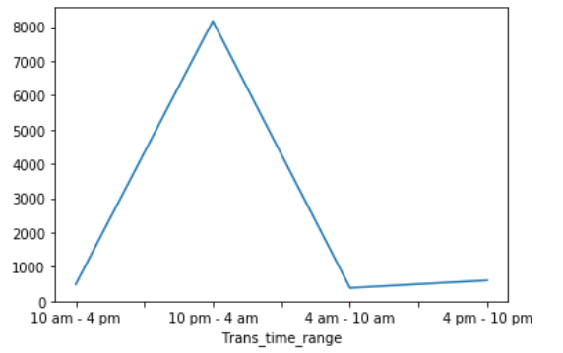
Fraudulent Transaction Hours.

Slide 13
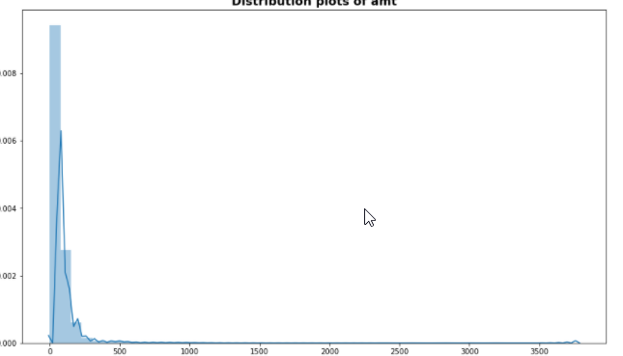
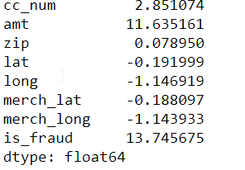
All the Numerical Features were left skewed

Slide 14
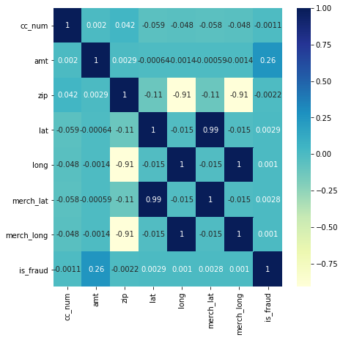
Correlation Matrix
The customers Location Coordinates are highly correlated with the Merchants

Slide 15
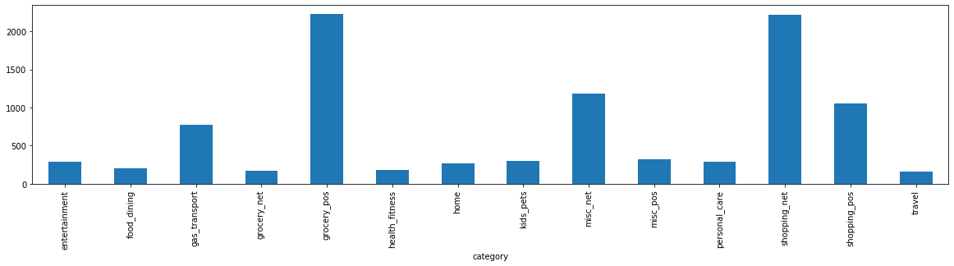
CATEGORY OF PURCHASES
THE HIGHEST FRAUDULENT TRANSACTIONS HAPPENED GROCERY POS AND SHOPPING_NETAMONG 14 CATEGORIES

Slide 16
THE BEST MODEL – Decision Tree with Hyperparameter Tuning
8 CLASSIFICATIONS MODELS DEVELOPED
1. Baseline Linear Model- Logistic Regression With-out balancing & With balancing data.
2. Decision Trees- With and Without Hyperparameter tuning.
3. Random Forests- With and Without Hyperparameter Tuning.

Slide 17
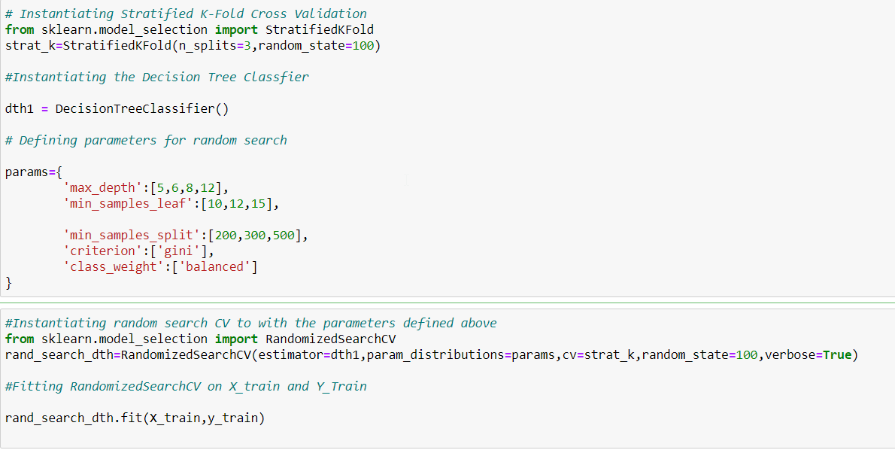

Slide 18
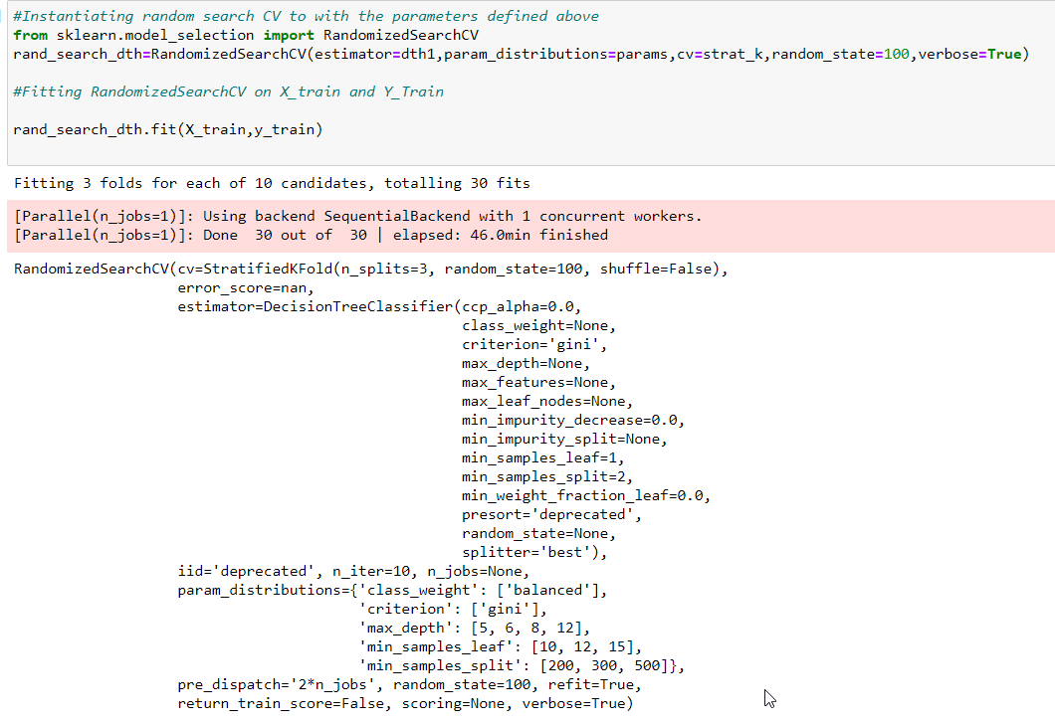

Slide 19
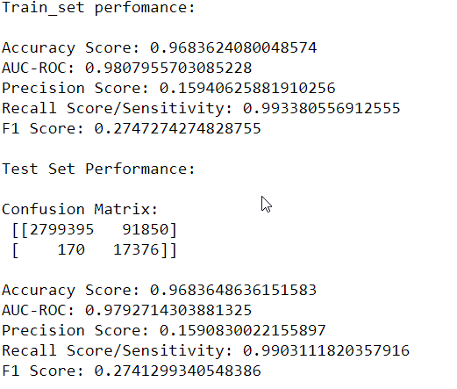
Decision Tree with Historical Variable- Hyperparameter Tuning was found to be the most cost efficient with overall good Performance Metrics.
Class Balancing: Class of weight method.
Cost Function is minimized pretty good.
Error Rate are pretty low.
Hence the Model Poses High Bias & Low Variance.

Slide 20
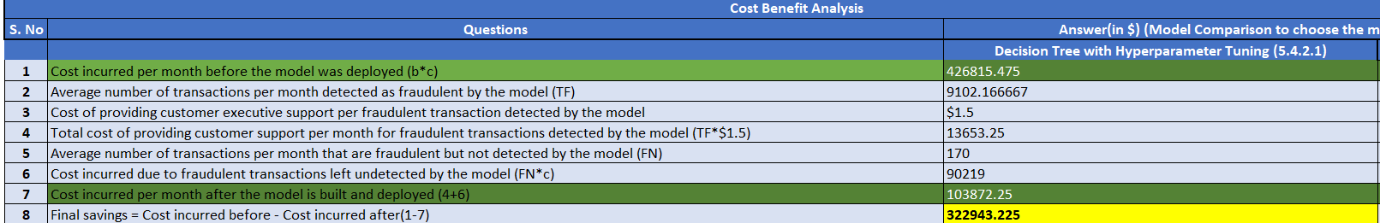
Cost Benefit Analysis
Final Savings was found as $322943.225.

Slide 21
CONCLUSION
THE LATE NIGHT AND EARLY MORNING HOURS ARE RISKY TIME PERIOD FOR FRAUDULENT TRANSACTION
DEPLOYMENT OF MACHINE LEARNING MODEL USING DECISION TREES WITH HYPER PARAMETER TUNING SAVE AS LARGE AS OVER $322943.225.
TRANSACTION TIME RANGE = 10:00PM – 4:00 AM

Slide 22
Recommendations
Finex must be more vigilant during late night hours and must provide two factor authentication for every transactions.
Finex set up daily limits on each user.
The model suggests, kids’s & pet’s category purchases must be tracked more proactively.
Any transactions on the card could be considered unsafe and immediate follow up with customer is must.

Slide 23
THANK YOU
ABDUS SAMAD ABDULLAH
SPECIALIZATION - DATA ANALYST
COURSE DSC-18

